Slide 1


Hope to Skills
Lecture# 02
Irfan Malik, Dr. Sheraz Naseer

Slide 2
ChatGPT: Possibilities for us ?

Slide 3
Basics of NLP

Slide 4
Stemming vs Lemmatization
Stemming | Lemmatization
Removing the last few characters of a given word, to obtain a shorter form, often leading to incorrect meanings and spelling | Lemmatization considers the context and converts the word to its meaningful short form
For example: Stemming the word ‘Caring’ would return ‘Car’ | For example: lemmatizing the word ‘Caring’ would return ‘Care’

Slide 5
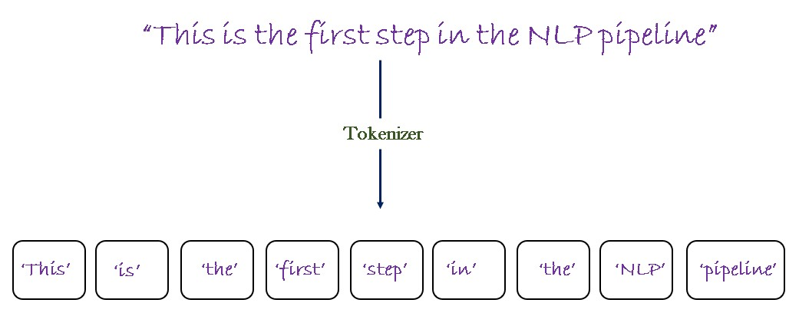
Tokenization
Definition: Tokenization is the process of breaking down text into smaller units called tokens, which can be words, phrases, or even characters.

Slide 6
Introduction to ChatGPT
ChatGPT stands for Generative Pretrained Transformer.
ChatGPT is an advanced AI language model developed by OpenAI.
ChatGPT revolutionizes Natural Language Processing.

Slide 7
Applications of ChatGPT
Content Generation
Text Summarization
Chatbots, Virtual Assistants, and Customer Support (Question Answering)
Language Translation
Interactive Storytelling
Education and Tutoring

Slide 8
Getting Started with chat.openai: A Tutorial for Beginners
(Click to skip the Tutorial)

Slide 9
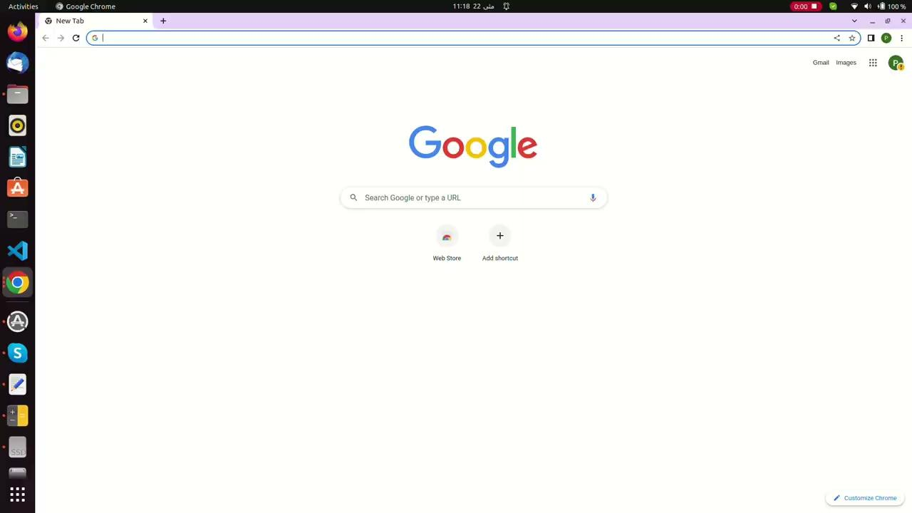
Step 1: Accessing chat.openai
To begin, open your preferred web browser and navigate to the chat.openai website. The website URL is https://chat.openai.com/auth/login .

Slide 10
Step 2: Creating an Account
If you already have an account, you can skip this step and proceed to Step 3. If not, you will need to create a new account.
Look for the "Sign Up" or "Register" button on the login page and click on it.
Click on “Continue with Google”, and then select your google account.
Follow the on-screen instructions to open the dashboard.

Slide 11
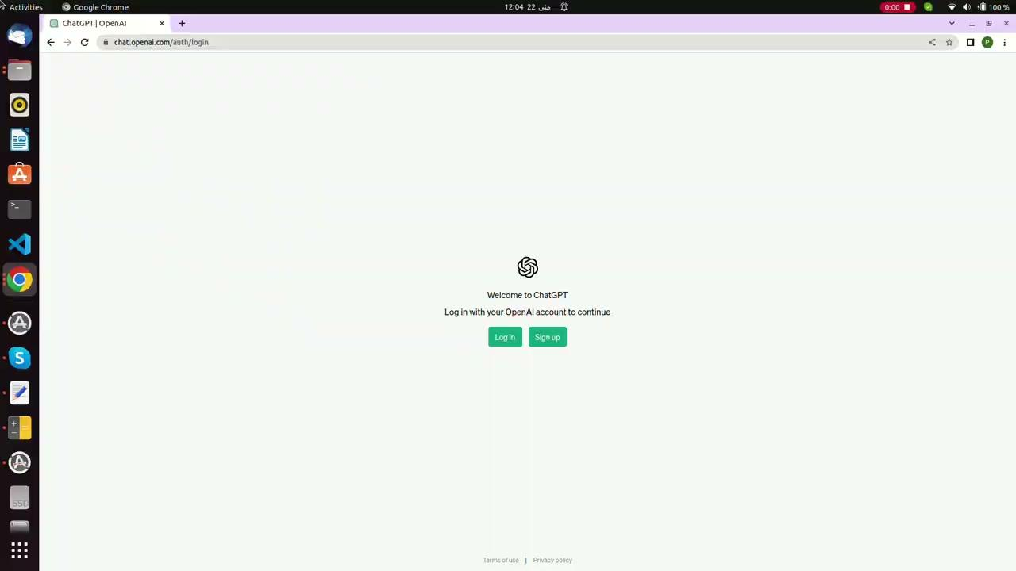

Slide 12
Step 3: Logging In
Click on the "Log In" button to access your chat.openai account.
Click on “Continue with Google”, and then select your google account.

Slide 13
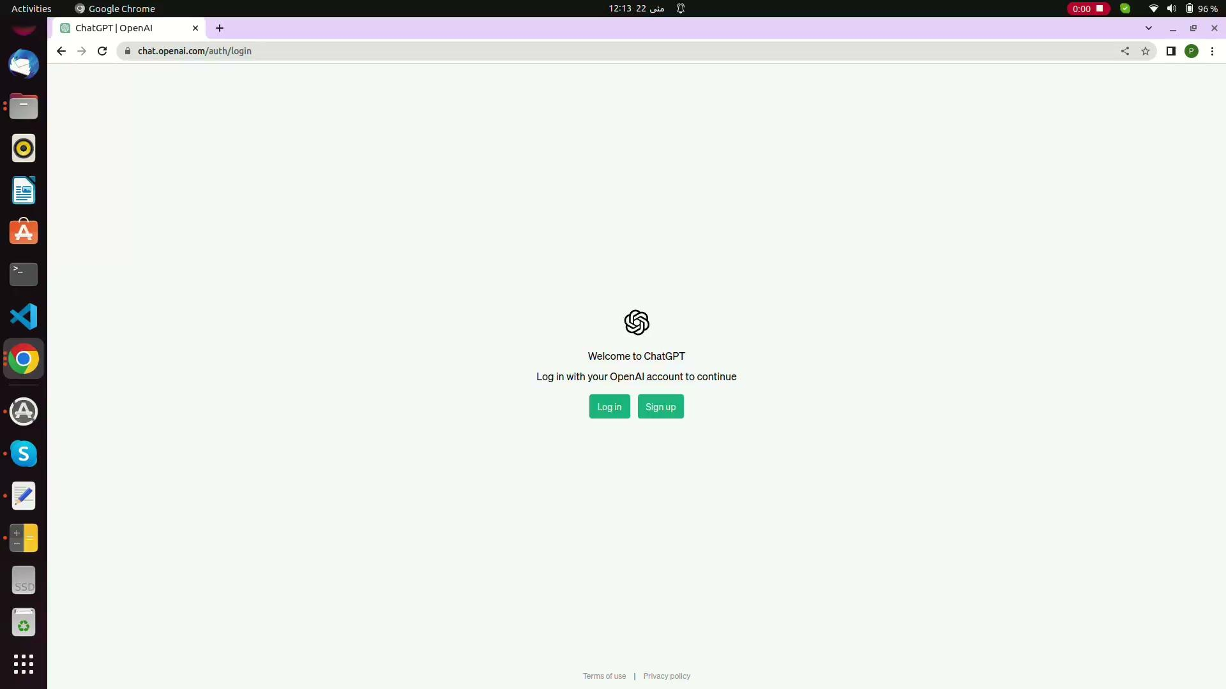

Slide 14
Step 4: Engaging in Conversation
In the chat interface, you will see a text input box where you can type your message or question.
Simply enter your text and press "Enter" or click the send button to send your query to the AI model.
Once you've sent your message, the AI model will process it and generate a response.

Slide 15
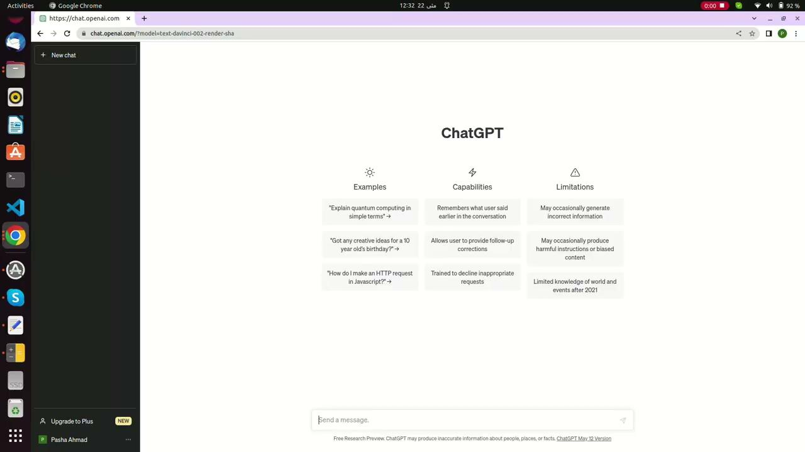

Slide 16
Tokens in Language Models
Definition: Tokens are the fundamental units of text used by language models. They can be as short as a single character or as long as a word or phrase.
Importance: Language models process text at the token level, allowing them to analyze and generate text based on the context and relationships between individual tokens.

Slide 17
Context in Prompting
Definition: Context refers to the information and preceding text that informs the language model about the desired output or influences its response.
Role of Context:
Guidance: Context helps shape the model's behavior and generate more accurate responses.
Relevance: Context ensures continuity and relevance in the generated text.
Interpretation: The language model uses context to understand the desired meaning and tone of the prompt.

Slide 18
Prompt Limits in Language Models
Definition: Prompt limits refer to the constraints imposed on the input provided to a language model.
Reasons for Prompt Limits:
Memory limitations: Language models have a finite capacity to process and store information.
Computational constraints: Longer prompts require more processing time and computational resources.
Response coherence: Extremely long prompts may result in less coherent or relevant outputs.

Slide 19
Temperature of Language Model
Definition: Temperature is a parameter used in language models that controls the randomness of generated text.
Purpose: Temperature determines the degree of exploration versus exploitation in the model's output.
Low Temperature (e.g., 0.1): Results in more deterministic and focused responses, with the model choosing the most probable tokens.
High Temperature (e.g., 1.0): Introduces randomness, allowing for more diverse and creative responses from the model.

Slide 20
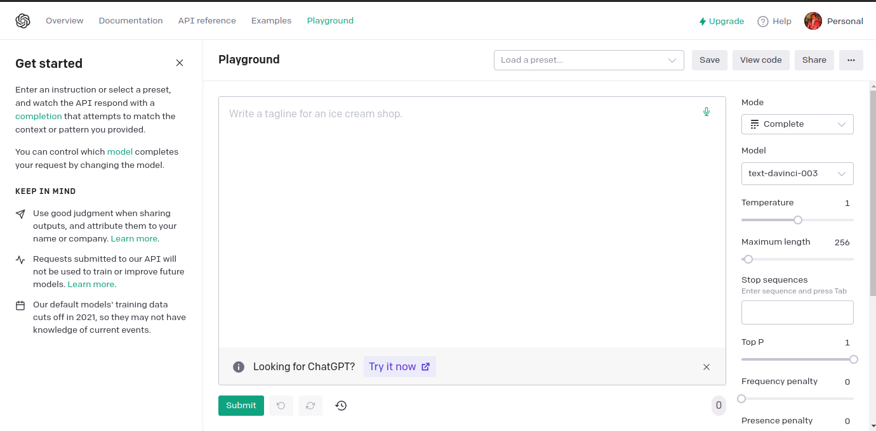
OpenAI Playground

Slide 21
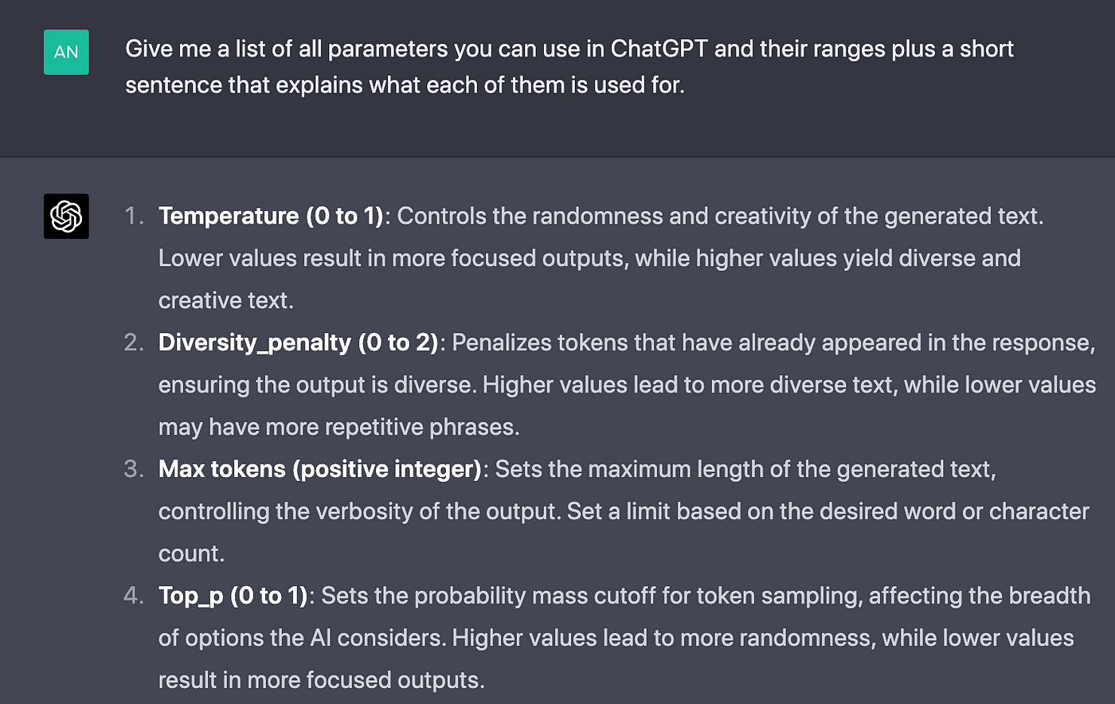
A Brief Overview

Slide 22
Prompt Engineering

Slide 23
What is Prompt Engineering?
Prompt engineering involves crafting tailored instructions or queries to guide the language model towards desired outputs.
It helps shape the behavior of the model and improves response quality.

Slide 24
Anatomy of Prompt
Definition: In the context of language models, a prompt refers to the input or instruction provided to the model to generate a specific response or output
Parts of a Good Prompt (Not all are necessary for each and every prompt. )
1- Simulate Persona
2- Task
3- Steps to complete Task
4- Context/Constraints
5- Goal
6- Format Output

Slide 25
General Structure of Prompt
Context: Start the prompt by providing relevant information or context that informs the model about the desired output.
Instruction: Clearly state the desired task, format, or outcome to guide the model's response.
Additional Details: Include any specific constraints, requirements, or specifications that shape the response.
Example: Provide an example or demonstration to illustrate the expected format or desired output.

Slide 26
Importance of Prompt Engineering
Ensures accurate and relevant responses.
Mitigates bias and promotes ethical use of AI.
Helps avoid undesired or harmful outputs.
Enables control over chatbot behavior.

Slide 27
Tips for Effective Prompt Engineering
Be explicit: Clearly specify the desired format or output.
Provide context: Offer relevant information or background to guide the model.
Control output length: Instruct the model to generate responses of a specific length.
Restrict responses: Utilize techniques like temperature adjustment to refine output quality.
Experiment and iterate: Refine prompts through experimentation and feedback loops.

Slide 28
Best Practices
Understand the model: Familiarize yourself with the strengths and limitations of the language model you are using.
Start simple: Begin with straightforward prompts and gradually refine them based on experimentation and feedback.
Domain-specific prompts: Tailor prompts to specific topics or domains to enhance response quality in specialized areas.

Slide 29
Open AI Playground
(Click here to use)

Slide 30
Scenario 1: Essay Writing For Students
Step 1 (Bad Prompt): "Write an essay about your favorite hobby."
Step 2 (Refined Prompt): "Write an engaging essay describing how your favorite hobby has positively influenced your personal growth and development."
Step 3 (Further Refinement): "Write an insightful essay explaining how your favorite hobby, such as playing a musical instrument, has enhanced your problem-solving skills, increased your patience, and boosted your self-confidence."

Slide 31
Scenario 2: Historical Event Analysis
Step 1 (Bad Prompt): "Analyze the causes of World War II."
Step 2 (Refined Prompt): "Provide a comprehensive analysis of the political, economic, and social factors that contributed to the outbreak of World War II, considering both domestic and international influences."
Step 3 (Further Refinement): "Compose a well-structured and nuanced analysis of the immediate triggers and long-term underlying causes of World War II, highlighting key events and decisions that escalated tensions and ultimately led to the global conflict."

Slide 32
Scenario 1: Diagnosis of a Patient's Symptoms
Step 1 (Bad Prompt): "Diagnose a patient with chest pain."
Step 2 (Refined Prompt): "Based on a patient presenting with acute chest pain, provide a differential diagnosis considering common causes such as angina, myocardial infarction, pericarditis, and gastroesophageal reflux disease (GERD)."
Step 3 (Further Refinement): "Analyze the symptoms, medical history, and relevant diagnostic tests of a patient experiencing acute chest pain, and formulate a well-reasoned diagnosis, including the most likely primary condition along with potential differential diagnoses that should be ruled out."

Slide 33
Scenario 2: Treatment Plan for a Chronic Disease
Step 1 (Bad Prompt): "Design a treatment plan for a patient with diabetes."
Step 2 (Refined Prompt): "Develop an individualized treatment plan for a newly diagnosed patient with type 2 diabetes, taking into account their age, lifestyle factors, comorbidities, and preferences, with a focus on diet modification and exercise."
Step 3 (Further Refinement): "Construct a comprehensive, evidence-based treatment plan for a middle-aged patient recently diagnosed with type 2 diabetes, addressing glycemic control, weight management, cardiovascular risk reduction, and patient education, while considering medication options, monitoring protocols, and psychological support."

Slide 34
Scenario 1: Debugging Code
Step 1 (Bad Prompt): "Fix the code. It's not working."
Step 2 (Refined Prompt): "Debug the provided code snippet and identify and correct any syntax errors or logical issues that prevent it from functioning as intended. Clearly explain the changes made and provide a tested version of the corrected code."
Step 3 (Further Refinement): "Analyze the given code segment, isolate the bugs, and systematically address each issue, including incorrect variable assignments, missing semicolons, and logical errors. Provide a comprehensive explanation of the debugging process and present a refined version of the code that produces the expected output."

Slide 35
Scenario 2: Algorithm Optimization
Step 1 (Bad Prompt): "Optimize the algorithm for sorting an array."
Step 2 (Refined Prompt): "Analyze the provided sorting algorithm and identify areas where its time complexity can be improved. Suggest specific modifications or alternative algorithms to achieve better performance."
Step 3 (Further Refinement): "Evaluate the time and space complexity of the given sorting algorithm, propose algorithmic modifications (e.g., switching from bubble sort to quicksort or introducing caching techniques), and explain the expected impact on efficiency. Discuss trade-offs and provide empirical evidence to support the proposed optimization."

Slide 36
Introduction to Stable Diffusion
A cutting-edge image generation tool utilizing stable diffusion models.
Generates realistic and high-quality images through advanced diffusion techniques.
Allows users to explore the possibilities of image generation by controlling diffusion parameters.
Used in various fields including art, design, and computer vision for diverse image generation tasks.

Slide 37

Introduction to Stable Diffusion (Try it)

Slide 38
Important Announcement
There will be a Quiz in the next lecture from the content of lecture#01 and Lecture#1.5

